Slide 1
DU RoboCup Architecture
David Chan, Paul Heinen, Dr. Mohammad Mahoor

Slide 2
Outline
Architecture Design
Development Environment
Resources

Slide 3
Architecture Design
The DU NAO-Engine is based on a free-step game engine.
Figures courtesy https://software.intel.com/en-us/articles/designing-the-framework-of-a-parallel-game-engine

Slide 4
Architecture Design
Figures courtesy https://software.intel.com/en-us/articles/designing-the-framework-of-a-parallel-game-engine

Slide 5
Architecture Design – Core Engine
Cloud & App System
Other Robots
Watchdog System
Debugging
Game Controller
Context-Frame Scheduler
Communication
Context
Context-Module Loader
Sensing
Robot
Motion
The Bazaar - ICC
AI

Slide 6
Architecture Design – Core Engine
Cloud & App System
Other Robots
Watchdog System
Debugging
Game Controller
Context-Frame Scheduler
Communication
Context
Context-Module Loader
Sensing
Robot
Motion
The Bazaar - ICC
AI

Slide 7
Architecture Design – Robot Pipeline
NAO DCM
NAO SDK
NAO-CORE Engine
Higher Level
Modules
Pineapple-Juice Shared Memory
HAL Module
Sensing
Robot
Motion

Slide 8
Architecture Design – What’s Done?
Cloud & App System
Other Robots
Watchdog System
Debugging
Game Controller
Context-Frame Scheduler
Communication
Context
Context-Module Loader
Sensing
Robot
Motion
The Bazaar - ICC
AI

Slide 9
Outline
Architecture Design
Development Environment
Resources

Slide 10
Development Axioms
Clarity
Ease of Use
Modularity

Slide 11
Development Environment – Clarity
Project designed with code clarity in mind
97,703 Lines of Code
Of those lines, over 12,000 are comments
Tutorials and Wiki Available (We’ll talk about that later)

Slide 12
Development Environment – Ease of Use
Dev Environment implemented as a Vagrant VirtualBox
Easy to deploy
Easy to onboard new members
Easy to begin devlopment
Installation as easy as
1. Install Vagrant
2. Download our Vagrant File
3. Run `vagrant up`

Slide 13
Development Environment – Modularity
Dev Environment can be used on any OS
Robot takes modular code, code can be compiled independently from the main source
This means that to compile a simple module change in a HLM, there’s no need to recompile the engine source
Modules can be developed independent of each other
LUA Environment allows for non-programmers to write code
Dynamic & Flexible system

Slide 14
Development Environment
So why us?
Current code is outdated
Current code is poorly documented
Current code is usually a fork of BHuman or rUNSWift, only incremental innovation

Slide 15
Outline
Architecture Design
Development Environment
Resources

Slide 16
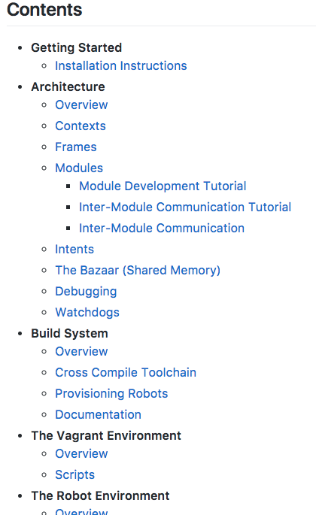
Resources – Wiki & Tutorials
Wiki covering all of the details needed to begin developing
Module writing tutorials available
Outside code discussion and explanations for developing on our platform

Slide 17
Resources – Slack
We provide a slack channel for people entering the group
24/7 communication on the team
Easy to get bug fixes/pushes

Slide 18
Resources – Issue Tracking
Github advanced issue tracking and change monitoring
Open Source allows for any team to make contributions to the code if we accept those changes
Fully ready for use in a large scaled environment
Easy to manage projects

Slide 19
Questions?

